Slide 1

A Summary on Smart Medical Appointment Scheduling: Optimization, Machine Learning, and Overbooking to Enhance Resource Utilization Authors: CATALINA VALENZUELA-NÚÑEZ , GUILLERMO LATORRE-NÚÑEZ , FREDY TRONCOSO-ESPINOSA
Name: Balu Anush Anthu Kumar
Subject: Emerging Paradigms
Instructor: Dr. Pooya Moradian Zadeh

Slide 2

Introduction
Research focuses on optimizing medical appointment scheduling using machine learning and overbooking to reduce inefficiencies and improve resource utilization.
Challenges include last-minute cancellations and no-shows, leading to long wait times and underutilization of healthcare resources.
Proposed system integrates linear programming and machine learning algorithms to predict patient attendance and enhance appointment management for better efficiency.

Slide 3

Problem Statement
The paper speaks about last-minute cancellations and no-shows disrupt patient flow, leading to wasted time and resources for healthcare providers.
These issues results in longer wait times for patients and decreased overall productivity in healthcare facilities.
Addressing this problem through predictive analytics and optimized scheduling algorithms can improve resource utilization and enhance the efficiency of healthcare services.

Slide 4
Importance and Challenges
Importance of Efficient Medical Appointment Scheduling
Efficient scheduling is crucial for maximizing healthcare delivery and patient satisfaction.
Optimized appointments can significantly reduce wait times and improve the allocation of medical resources.
Challenges in Current Scheduling Systems
No-shows: A major issue, leading to wasted resources and reduced availability for other patients. Typically results in significant financial losses for healthcare facilities annually.
Resource Underutilization: Inefficient scheduling often leads to underutilization of staff and facilities, increasing operational costs and decreasing the potential to serve more patients effectively.

Slide 5

Objective of the Study
Optimizing Appointment Scheduling
The primary goal of this study is to address and mitigate the inefficiencies in medical appointment scheduling systems.
By leveraging advanced machine learning algorithms, the study aims to predict patient attendance accurately, enabling a more dynamic scheduling process.
Incorporating Overbooking Strategies
Recognizing the inevitable occurrence of no-shows, this study proposes the strategic use of overbooking.
The objective is to ensure that the maximum number of appointments can be honored without overburdening healthcare providers or compromising patient care quality.
A Dual Approach for Efficiency and Effectiveness
The integration of machine learning for prediction and overbooking strategies represents a novel approach to optimizing medical scheduling.
This dual strategy aims to enhance the utilization of healthcare resources, reduce waiting times for patients, and ultimately provide a more efficient healthcare service delivery.

Slide 6

Proposed Solution
Integrates a linear programming model to strategically manage overbooking and ensure better utilization of healthcare resources.
Utilizes machine learning to predict patient attendance and optimize appointment scheduling for improved efficiency and reduced wait times.
Addresses scheduling challenges by leveraging technology to minimize the impact of last-minute cancellations and no-shows on resource allocation.

Slide 7
Methodology
Overview of the Integer Linear Optimization Model
This model is at the heart of our scheduling optimization approach, designed to allocate appointments efficiently across available time slots.
It considers various constraints, such as healthcare providers' availability, patient preferences, and expected service times, aiming to maximize the overall utilization of healthcare resources.
The optimization process iteratively adjusts the scheduling plan to minimize idle times and ensure a smooth flow of patient appointments.
Machine Learning Techniques for Predicting Patient No-Shows
To enhance the model's effectiveness, the model incorporates predictive analytics using machine learning algorithms.
These techniques analyze historical patient data, identifying patterns and factors associated with the likelihood of no-shows.
By integrating these predictions into the scheduling model, we can more accurately anticipate and mitigate the impact of no-shows through strategic overbooking, ensuring that resources are utilized efficiently.

Slide 8
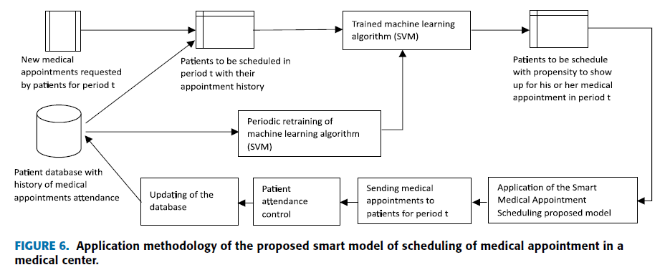
Proposed Flowchart

Slide 9

Data Analysis and Results
Dataset: The study analyzed data from 340,000 medical records at Dr. Guillermo Grant Benavente Hospital, focusing on the first semester of 2021. The model's efficiency was validated through a five-month training period and a subsequent test in June 2021.

Slide 10
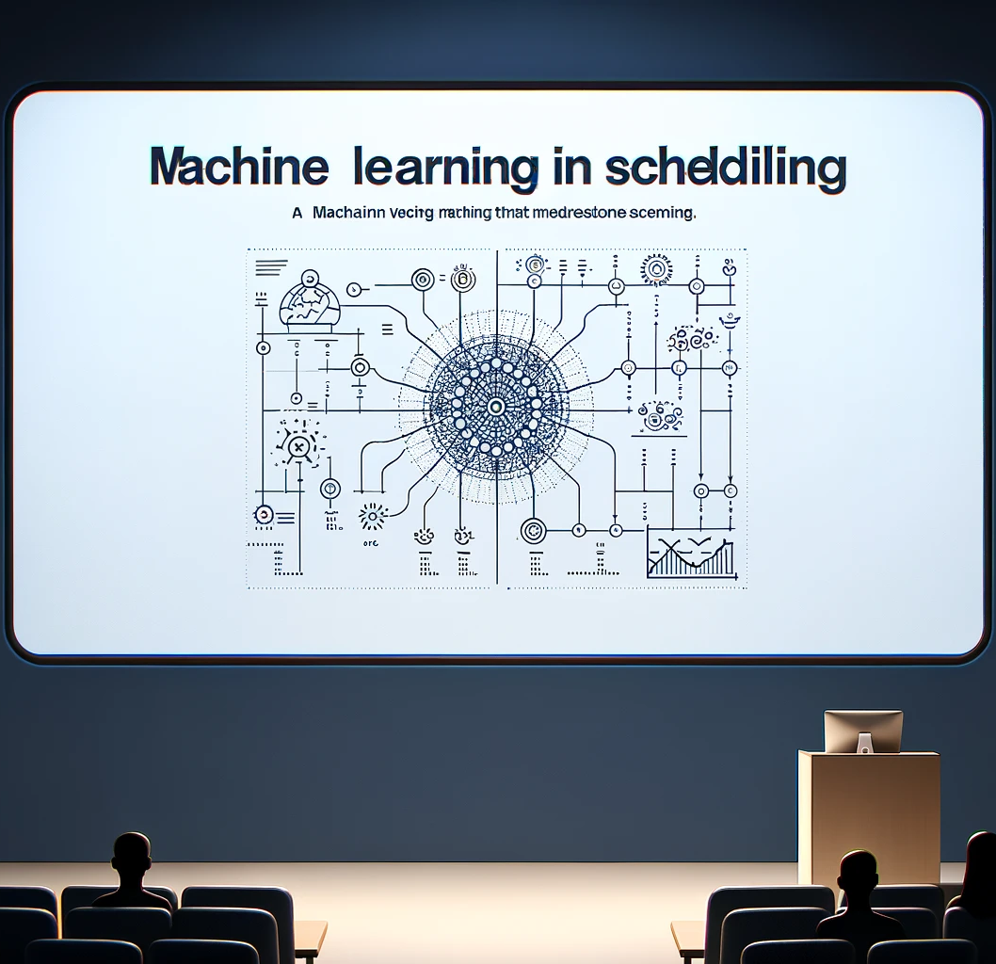
Machine Learning in Scheduling
Support Vector Machine (SVM) is a type of machine learning algorithm used for classification, regression, and outlier detection tasks, which works by finding the best boundary that separates data points into classes.

Slide 11
Why Support Vector Machine?
Superior Performance: Selected due to its better performance in Recall, F-measure, and AUC, critical for predicting patient no-shows.
Propensity Estimation for No-shows: Utilizes SVM to estimate patients' likelihood of attending appointments, key for optimizing resource use.
Data-Driven Scheduling Integration: Incorporates SVM predictions for strategic overbooking, balancing no-show risks with the opportunity to serve more patients.
Continuous Model Improvement: Emphasizes regular retraining to adapt to behavioral changes and maintain predictive accuracy.

Slide 12
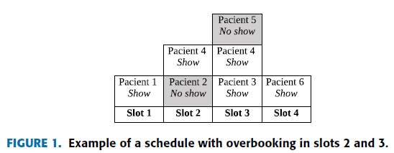
Overbooking Strategy
Priority
Types of Patients
Recurrent
First-time

Slide 13

Overbooking Strategy
- Overbooking strategically schedules more appointments than capacity, anticipating no-shows and cancellations to minimize idle time and maximize resource utilization.
- By leveraging overbooking, appointment schedules become more flexible, reducing wait times for patients and ensuring efficient and effective use of healthcare resources.
- Integrating machine learning algorithms with overbooking helps predict patient attendance, allowing for proactive adjustment of schedules and optimizing resource allocation.

Slide 14
Results
Model Performance: The model demonstrated a superior scheduling algorithm with a confidence metric of 0.95 compared to random scheduling, effectively managing patient types and overbooked slots, achieving 56.29% occupancy, higher than the hospital's 52.26%.

Slide 15
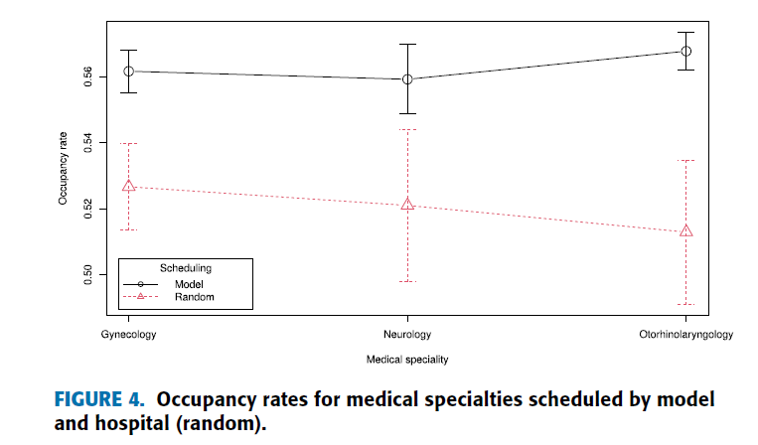
Results

Slide 16

Advantages
- The new system leverages machine learning and overbooking techniques to optimize scheduling, aiming to improve efficiency and reduce wait times.
- By predicting patient attendance using machine learning algorithms and a linear programming model, the system ensures better utilization of healthcare resources.
- Addressing challenges like last-minute cancellations, the system is designed to minimize inefficiencies and enhance overall healthcare resource management.

Slide 17

Advantages
- Enhances operational efficiency by optimizing scheduling, reducing wait times, and utilizing resources effectively through machine learning and overbooking.
1
- Improves patient experience by minimizing appointment delays, enhancing convenience, and ensuring timely access to healthcare services.
2
- Integrates predictive analytics to forecast patient attendance, enabling proactive appointment management and enhancing overall healthcare service delivery.
3

Slide 18
References
[1] Valenzuela-Núñez, C., Latorre-Núñez, G., & Troncoso-Espinosa, F. (2024). Smart Medical Appointment Scheduling: Optimization, machine learning, and overbooking to enhance resource utilization. IEEE Access, 12, 7551–7562. https://doi.org/10.1109/access.2024.3349953

Slide 19

Questions?

Slide 20


